Slide 1
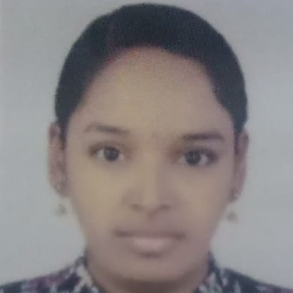



A Jaya Sree Mahalaxmi
Bachelor of Engineering
Computer Science : 2017 - 2021
Analyst/Software Engineer
Skills
Java 8 /J2EE | Java Basics, OOPS, Generics, Collections, Arrays, Loops, Lambda Exp, Stream API Junit, Mockito, Servlets
Spring core | IOC & Dependency Injection, Autowire
Spring REST | REST controllers, Implementation of GET, POST, PUT & DELETE, Bean Validation & Exception Handling, Testing Services, Controller & Repository layer
Spring Data JPA | Implement DAO layer using spring Data repositories, Transaction Management
Spring Boot Microservices | Spring Boot Starters, annotations, Messaging Service, Sync/Async comms, Swagger API documents
Spring Cloud | Eureka, Netflix Ribbon, Feign Client, Netflix Hystrix, Netflix Zuul & Config Server
React | Components, Hooks, Event handling, Redux, Reducers, Testing using Jasmin & Karma
Database | MongoDB No Sql Basics My SQL RDS Basics
UI Tech | HTML 5 & CSS 3,JavaScript, ES6 & TypeScript Reusable templates, Optimized UI Designed
Tools | Git, Postman, Maven, IDE
Devops | CI/CD, Jenkins configuration, Build Pipelines, notifications, quality gate understanding
Add On skills | Communications, Team management. Peer learning
Bangalore
xxxxxxxxxxx@capgemini.com
+91 xxxxxxxxxxxx
A4
Full Stack Developer
Hands on experience in creating microservices with Spring boot, Spring Security, Spring Cloud API Gateway, Eureka server, resilience 4J, load balancing, Sleuth
Proficient in creating Single page Web Application in React with Authentication with route guards
Hands on experience in implementing Microservice architecture with NodeJS & spring boot
Experience in creating documentation with Java docs and swagger and in unit testing using Junit, Mockito.
Java Microservice Development knowledge using Spring boot and spring cloud framework on an intermediate level.
Online Hotel Management System
Completed end to end case study of Online Hotel Management System Application along with JWT authentication, Swagger.
Certifications
AWS Cloud Practitioner
Completed this course by having hands on practice on the cloud service like creating a bucket , VPN connection ,red shift data services in database management etc.
Agile Software Development
Check out my work on GitHub & Video Profile

